Slide 1
NWEN304 Group Project Presentation – Group 7
Shengkun Xie
Colton Vermilyea
Zhen Wang
https://github.com/NWEN304Group/GroupProject
https://nwen304-shopping-project.herokuapp.com

Slide 2
Who worked on what:
Shengkun Xie:
1.Signup, Login/Logout(basic1 a, b)
2.Setup database for user functions (basic 3)
3.Use OAuth / OpenID and online service (Facebook login) for user registration and authentication (completion 1)
4.Implement a simple product recommendation service that uses the local
weather conditions (challenge 1)
5.Support timeout fuction (challenge 2)
6.RESTful interface and curl tests for user functions (mandatory)
Colton Vermilyea:
1. Host the application in a cloud service (Basic 3)
2. Use HTTPS to facilitate secure communication (Basic 4)
3. Manage the use of HTTP cache headers to improve application response times (Completion 3)
4. Evaluate and measure application performance (Challenge 3)
Zhen Wang:
1. Set up product display (Basic 1)
2. Database setup (Basic 3)
3. Develop shopping cart functionality (Completion 2)
4. Implement a product recommendation service that uses purchase history (Challenge 1)
5. Develop test cases for the API and manage error handling (mandatory)

Slide 3
Application Pages
1. Home Page (not logged in)
2. Home Page (user logged in)
3. Login Page
4. Signup/Registration Page
5. Profile Page
6. Edit Profile Page
7. Product Category Page
8. Individual Product Page
9. Cart Page
Database Schema
mlab.com/databases/newn304groupproject
github.com/NWEN304Group/GroupProject
https://nwen304-shopping-project.herokuapp.com

Slide 4
REST interface
API Design
GET / | NaN | get index page of website | index web page200 OK | 404 Not Found
GET /login | NaN | get login page | login web page200 OK | 404 Not Found
POST /login | email and password | login user | profile page200 OK | User not found/Password wrong401 Bad Request
GET /profile | NaN | get profile page | profile page200 OK | user not found401 redirect to login page
POST /profile | name, address | update profile | profile page200 OK | user not found401 redirect to login page
GET /signup | NaN | get signup page | signup page200 OK | 404 Not Found
POST /signup | name, email, password | signup a new user | profile page200 OK | email already exist401 Bad Requestredirect to profile page

Slide 5
REST interface
API Design
URL + HTTP Verb | Parameters | Description | Response status and body (when successful) | Response status and body (when failed)
‘/products/:category_id’+get | category_id | a page that show all products of one category | 200 OK | 500:Request:+req..category_id
‘/product/:product_id’+get | product_id | a page that show details of a product | 200 OK | 500error:err,:,:+req..product_id

Slide 6
REST interface
API Design
‘/page/:page’+get | page | a page that show products that index is :page | 200 OK | 500error:err,:,:+ req..
‘/pagenotlogin/:page’+get | page | Get a page that show show products that index is :page with login buttons | 200 OK | 500:err,:,:+ req..
‘/product/:product_id’+post | product_idUser_id | add product to user's cart and update cart | 200 OK | 500error:err,:,:+ req...product_id
‘/cart’+get | user._id | Show cart page | 200 OK | 500:err,:,:
‘/removeall’+post | user._idreq.body.item | remove all quanlity of one product in cart | 200 OK | 500error:err,:,:

Slide 7
REST interface
API Design
‘/removeone’+post | user._idreq.body.item | Remove 1 quanlity of one product in cart | 200 OK | 500:err,:,:
‘/payment’ + get | User id | confirm payment | 200 OK | error:err,:,:

Slide 8
Shopping Cart Design and Implementation
(Alex)
1. update user schema
2. add cart shcema
3. //add product to user's cart and update cart
post('/product/:product_id', function (req, res, next)
4.get('/cart', function (req, res, next)
5.post('/removeall', function (req, res, next)
6.post('/removeone', function (req, res, next)
7.get('/payment', function (req, res, next)

Slide 9
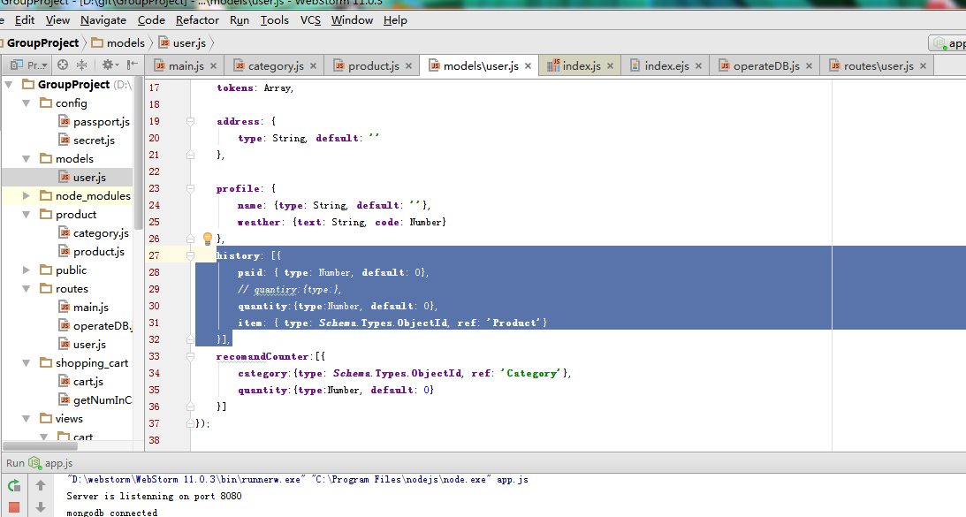
Shopping Cart Design and Implementation
(Alex)

Slide 10
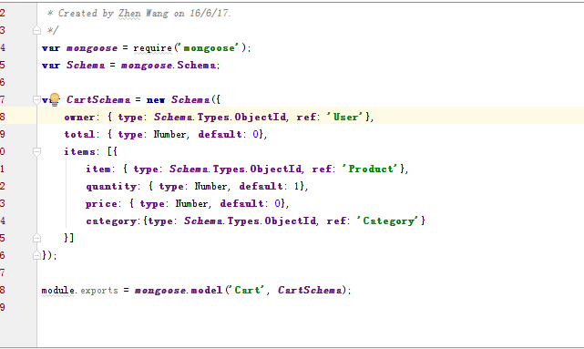
Shopping Cart Design and Implementation
(Alex)

Slide 11
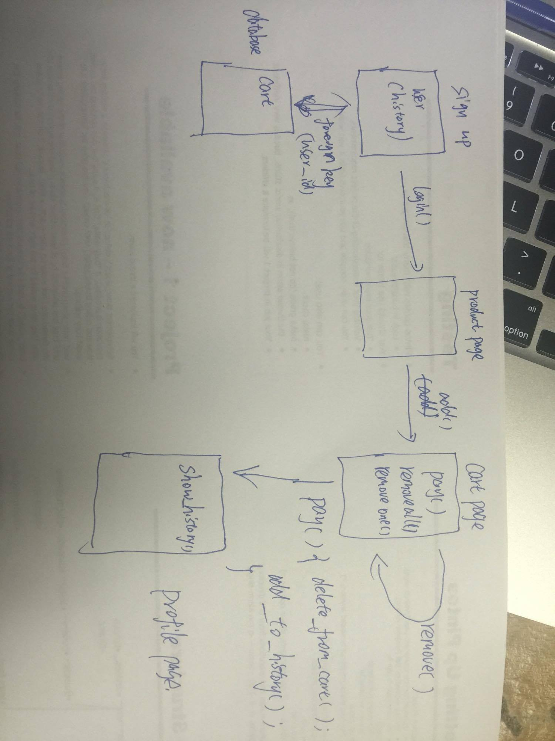
Shopping Cart Design and Implementation
(Alex)

Slide 12
Signup, Login and Facebook login
Email, username, password
Facebook login
Security (bcrypt)

Slide 13
Weather based products recommendation Implementation
1
Sent geographical information to Yahoo weather
Client
Yahoo
Get weather information back
3
2
Sent weather information to server
Sent recommendations to client
6
4
Server
Database
Get products from database based on weather information
5
In order to protect the privacy of users, we only collect user’s weather information.
We do not collect user’s geographical location.

Slide 14
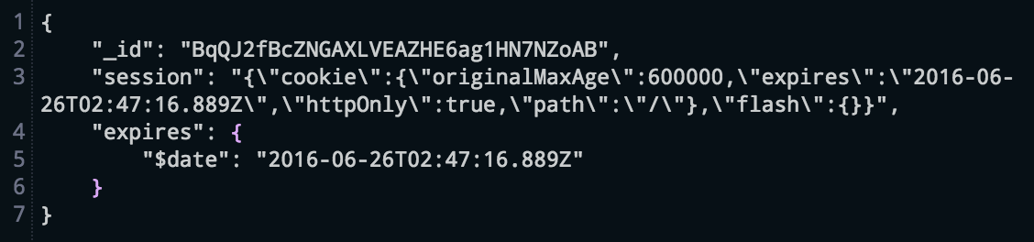
Time out function
Connect mongo

Slide 15
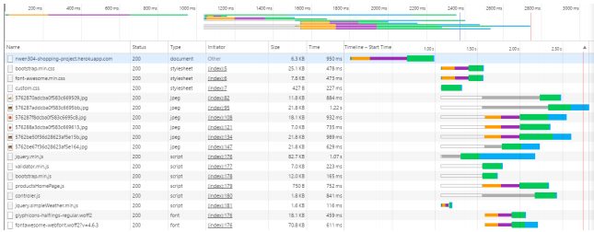
Caching
(Colton)

Slide 16
Application Performance
(Colton)

Slide 17
Try to relate some of these things to what we covered in class
1.express
2.nodejs
3.mongodb
4.http header
5.security
6.privacy
7.OAuth

